Slide 1

Crowd management solutions
hacktuators

Slide 2


PROBLEMS OF INEFFICIENT MANAGEMENT
PROBLEM 1
PROBLEM 3
PROBLEM 5
Leads to Stampede, causes serious accidents.
Minors may get lost in the crowd and cannot be traced.
For efficient Management, more number of workers are needed.
PROBLEM 2
PROBLEM 4
During any pandemic, leads to greater spread of diseases.
Number of Crowd may exceed occupancy limit.

Slide 3




Solution
Importance of object detection
Using Well-Trained Models, Number of People can be detected in a frame.
Videos can be feeded to model using CCTV footage or any other live source for real-time.
Number of People can be used to calculate whether it is less than occupancy limit or not.

Slide 4
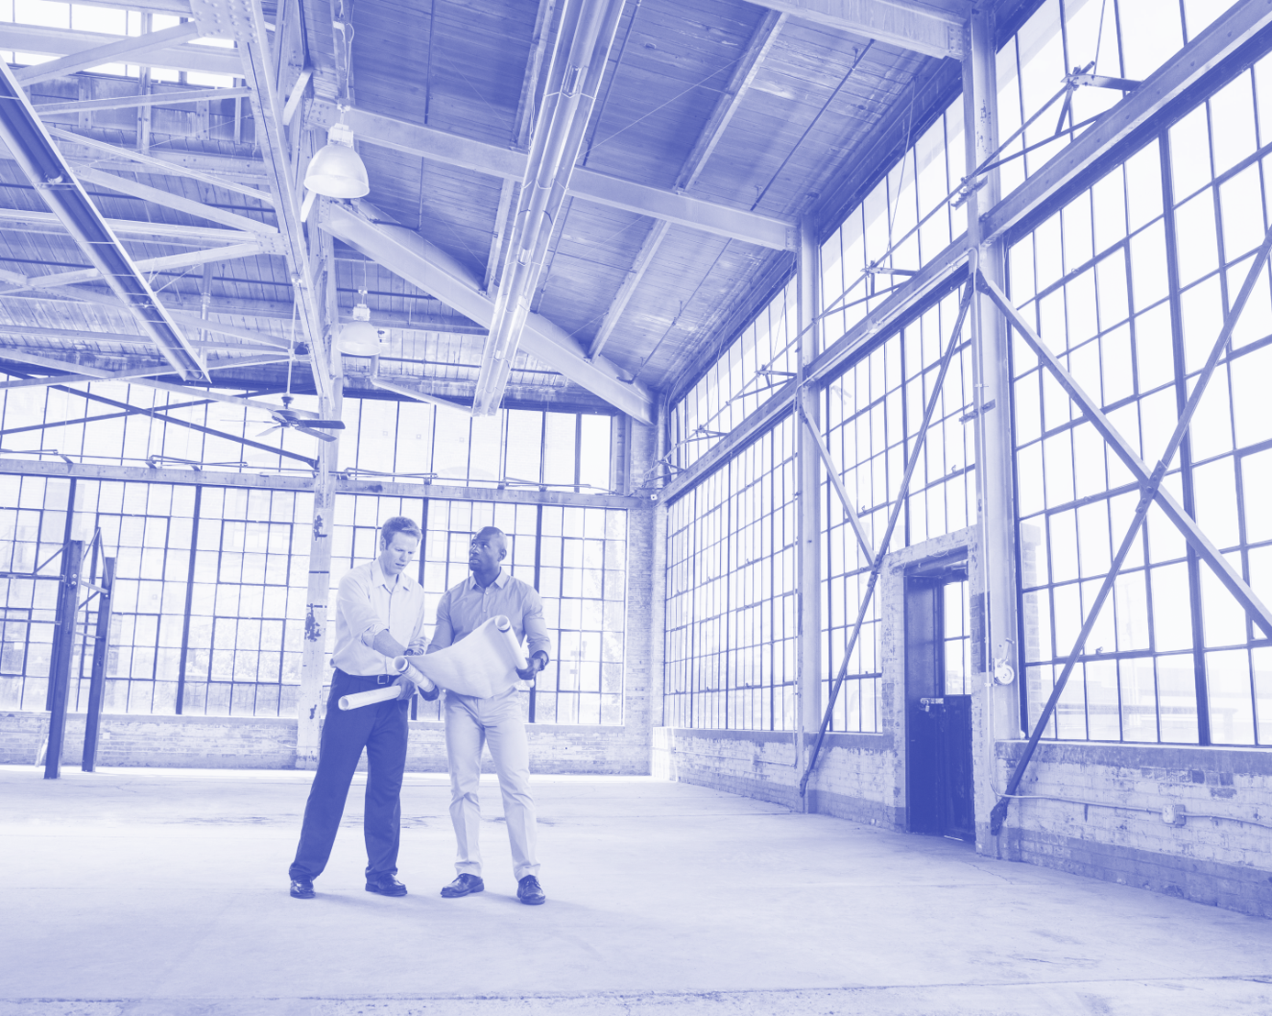

Advantage
Everything is automated. It requires less staff for Crowd Management and booking allocations. No need for monitoring all time. Necessary actions may be taken when required. Hence profitable for organisation.
More accurate than physical counting.
Can help in reducing accidents, or a customised pre-trained model of lost children may help in tracing them from cameras. Overally, it is efficient.

Slide 5


Prototype
People counter & alarm system
Counts number of People in a frame
When number exceeds, reports to the admin
Keeps track of the records , real-time.

Slide 6

Impact & profits
Scalability of model
People Detection Model can be also used in face detection in nearer view, which can be used in automated attendance systems.
People Counter can be implemented in malls, airports, hospitals, event organisations, where track of people is necessary.
People Action Detection can be made which can predict mobs before event, preventing an accident.
Hourly based people count can be given to organisations to analyse data and increase their profits.
People Detection can be extended to Object Recognition, Vechile Detection and many more applications are possible using Object Detection. So this model is scalable and profitable.

Slide 7

Future plans
Alongwith People Detection, we would like to add variations, so that it can recommend event organisers or managers and assist them in organising events.
It can be a helping AI tool for successful events.

Slide 8

Thank you
hacktuators

